Slide 1

Replikasi &
Mirroring pada
Basis Data

Slide 2



Profil
Nama : Panji Iman Baskoro
NRP : 171111023
“My assignment is recently overdue”
Nama : luna ?
NRP : NRP?
“hmmmm”

Slide 3
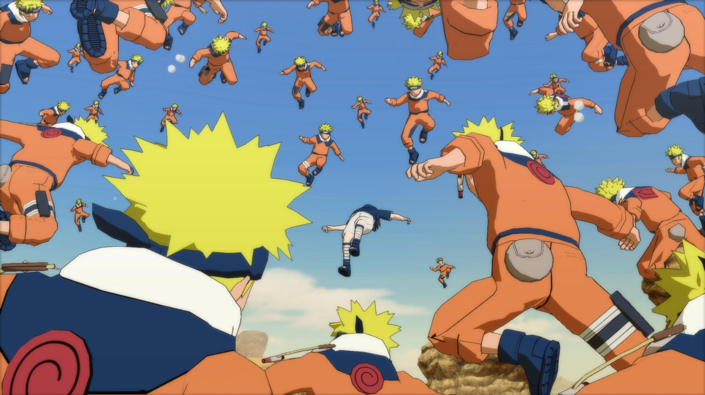
Replikasi
Replikasi
Gambar kage bunshin naruto menjelaskan tentang replikasi; gambar diambil dari google

Slide 4

Mirroring
Justin timberlake menyayikan lagu mirror

Slide 5
Justin timberlake - mirror
Aren't you something to admire, 'cause your shine is something like a mirror
And I can't help but notice, you reflect in this heart of mine
If you ever feel alone and the glare makes me hard to find
Just know that I'm always parallel on the other side
'Cause with your hand in my hand and a pocket full of soul
I can tell you there's no place we couldn't go
Just put your hand on the glass, I'm here trying to pull you through
You just gotta be strong
'Cause I don't wanna lose you now
I'm looking right at the other half of me
The vacancy that sat in my heart
Is a space that now you hold
Show me how to fight for now
And I'll tell you, baby, it was easy
Coming back into you once I figured it out
You were right here all along
It's like you're my mirror
My mirror…
O ooo

Slide 6
Justin timberlake - mirror
Aren't you something to admire, 'cause your shine is something like a mirror
And I can't help but notice, you reflect in this heart of mine
If you ever feel alone and the glare makes me hard to find
Just know that I'm always parallel on the other side
'Cause with your hand in my hand and a pocket full of soul
I can tell you there's no place we couldn't go
Just put your hand on the glass, I'm here trying to pull you through
You just gotta be strong
'Cause I don't wanna lose you now
I'm looking right at the other half of me
The vacancy that sat in my heart
Is a space that now you hold
Show me how to fight for now
And I'll tell you, baby, it was easy
Coming back into you once I figured it out
You were right here all along
It's like you're my mirror
My mirror…
O ooo

Slide 7
+
NDB
=
What a lul !!

Slide 8

+
NDB

Slide 9
What is NDB?
it’s a storage engine
It’s faster *
It’s HA
It’s Supported Cluster build
And absolutely it’s cool

Slide 10
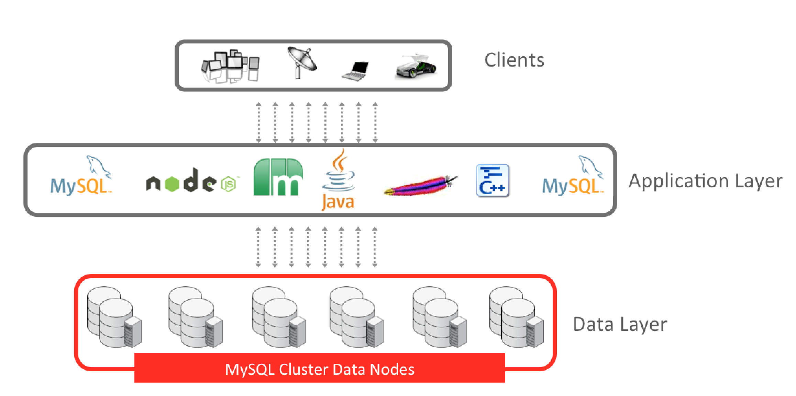
NDB Cluser Layer
a.k.a Mysql Cluster Layer

Slide 11
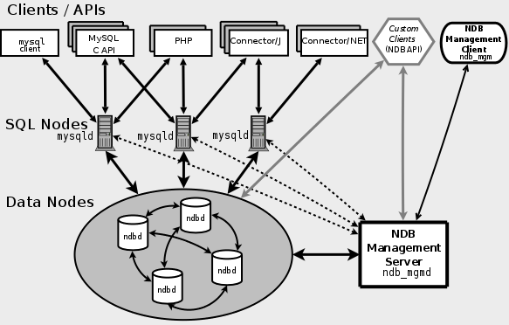
NDB Cluser Diagram
a.k.a Mysql Cluster Diagram

Slide 12
+

Slide 13


Docker Cluster
For mysql-server with ndbd & ndb_mgmb
Data-Node
cluster
ndb1
Mysql workbench
mysql_client
ndb_mngmnt
ndb2

